Slide 1
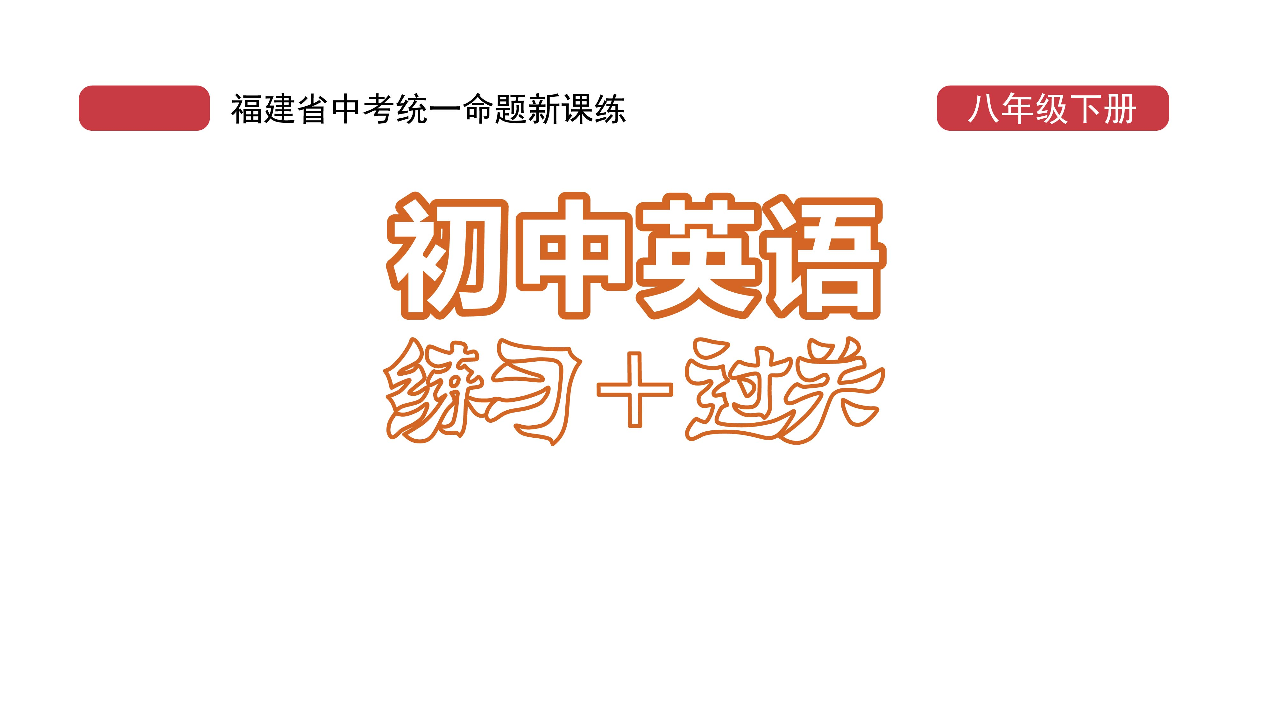
课时练习
模块五 第三章 第四节

Slide 2
一、翻译下列词组。
1. 保持好心情 _____________________________
2. 照顾 ___________________________________
3. 睡一个好觉 _____________________________
4. 保持沉默 _______________________________
stay in good spirits/a good mood
take care of
have a good sleep
keep silent

Slide 3
一、翻译下列词组。
5. 从……中获得帮助 _______________________
6. 仔细考虑 _______________________________
7. 作出重要决定 ___________________________
8. 幸福感 _________________________________
get help from …
think it over
make an important decision
a sense of happiness

Slide 4
二、用括号内所给单词的适当形式填空， 每空不限词数。
1. Jim has been in low ________ (spirit) these days.
2. We will study the report carefully before making a _________ (decide).
3. Look! Can you see the old man _______ (lie) on the road? Let’s help him.
spirits
decision
lying

Slide 5
二、用括号内所给单词的适当形式填空， 每空不限词数。
4. Do something _________ (relax) before going to bed—read a book, or take a hot bath.
5. A group of elephants in Yunnan have trouble ________ (find) their home.
relaxing
finding

Slide 6
三、单项选择。
( )1. Sitting at a comfortable(舒适的) place and eating bamboo is the best way for pandas to _______.
A. relax B. relaxing C. relaxed
A

Slide 7
三、单项选择。
( )2. —What do you think of my advice?
—I’ll _______ and give you an answer next week.
A. think it over B. think it about C. think it up
A

Slide 8
三、单项选择。
( )3. The _____ boy has been in hospital for about two months. The doctor says he has serious heart _____.
A. ill; disease B. sick; disease C. sick; illness
B

Slide 9
三、单项选择。
( )4. Cathy wasn’t sure if the book was the right one, but she bought it ______.
A. however B. whatever C. anyway
B

Slide 10
三、单项选择。
( )5. Our English teacher is nice and patient(有耐心的), though she is very _______ us.
A. confident about B. proud of C. strict with
C

Slide 11
四、翻译下列句子，并判断它们的句子类型，将选项填在括号内。
A. 主语+系动词+表语 B. 主语+谓语
C. 主语+谓语+宾语 D. 主语+谓语+间接宾语+直接宾语
E. 主语+谓语+宾语+宾语补足语 F. There be结构
1. 这个女孩不会唱歌和跳舞。
__________________________ ( )
The girl can’t sing or dance.
B

Slide 12
四、翻译下列句子，并判断它们的句子类型，将选项填在括号内。
2. 她的脸变红了。
_________________________ ( )
3. 瓶子里没有水。
_______________________________
_______________________________ ( )
Her face turned red.
A
There is no water in the bottle./
There isn’t any water in the bottle.
F

Slide 13
四、翻译下列句子，并判断它们的句子类型，将选项填在括号内。
4. 我借来了五本书。
_____________________ ( )
5. Peter的妈妈给他买了一辆自行车。
_______________________________ ( )
6. 我昨天听见我的邻居在弹钢琴。
___________________________________________ ( )
I borrowed five books.
C
Peter’s mother bought him a bike.
D
I heard my neighbor playing the piano yesterday.
E

Slide 14


